Slide 1

Diary Management System
Team: Sweet Dreams

Slide 2
Table of Contents
Table of Contents | 2
Team Description | 3
System Description | 4
External Model | 6
Conceptual Model | 7
Enhanced Entity Relationship Model (EER) | 8
Creating the Database | 10 - 16
Loading Data | 17 - 18
Performance Enhancements | 19 - 20
Graphical User Interface (GUI) | 22 - 24
References | 25
2

Slide 3

Team Description
Evan Spillane ............................. Evan.Spillane1@marist.edu (Team Head)
-Junior from PA majoring in Cybersecurity and Philosophy
Connor Fleischman ........ Connor.Fleischman1@marist.edu (Team Member)
-Sophomore from NY majoring in Computer Science
Lilli Cartiera ........................... Lilliana.Cartiera1@marist.edu (Team Member)
-Junior from CT majoring in Math and Data Science
Abel Scholl .................................. Anna.Scholl1@marist.edu (Team Member)
-Sophomore from PA majoring in Computer Science
Neo Pi ..................................................Neo.Pi1@marist.edu (Team Member)
-Junior from NJ majoring in Cyber Security
3

Slide 4
System Description
Allow a user to…
Record daily events and experiences
Add, edit and delete records
Experience the system based on their role/permissions
Suitable for a small company or group to manage daily happenings.
4
Notes:
Lilli

Slide 5
Entity Relationship Model
Entity Relationship Model
5
Notes:
Evan

Slide 6
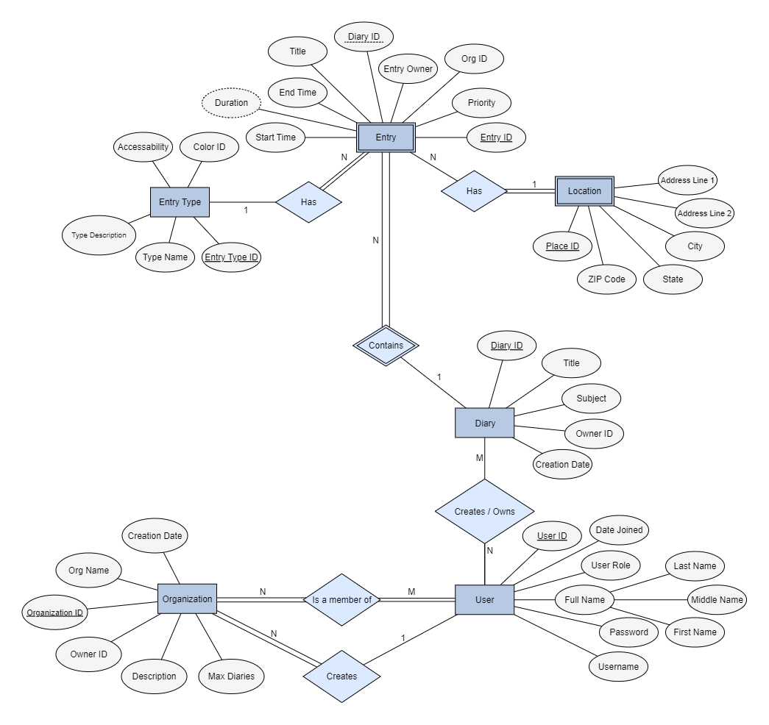
External Model
6
6
Notes:
Evan

Slide 7
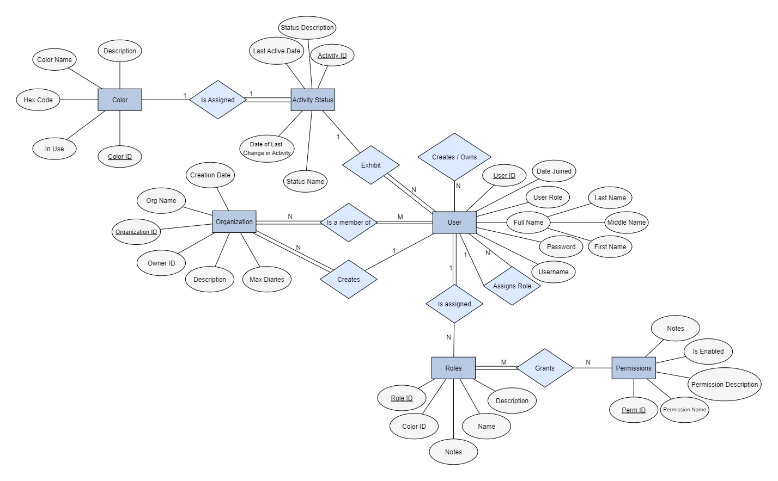
Conceptual Model
7
Notes:
Evan

Slide 8
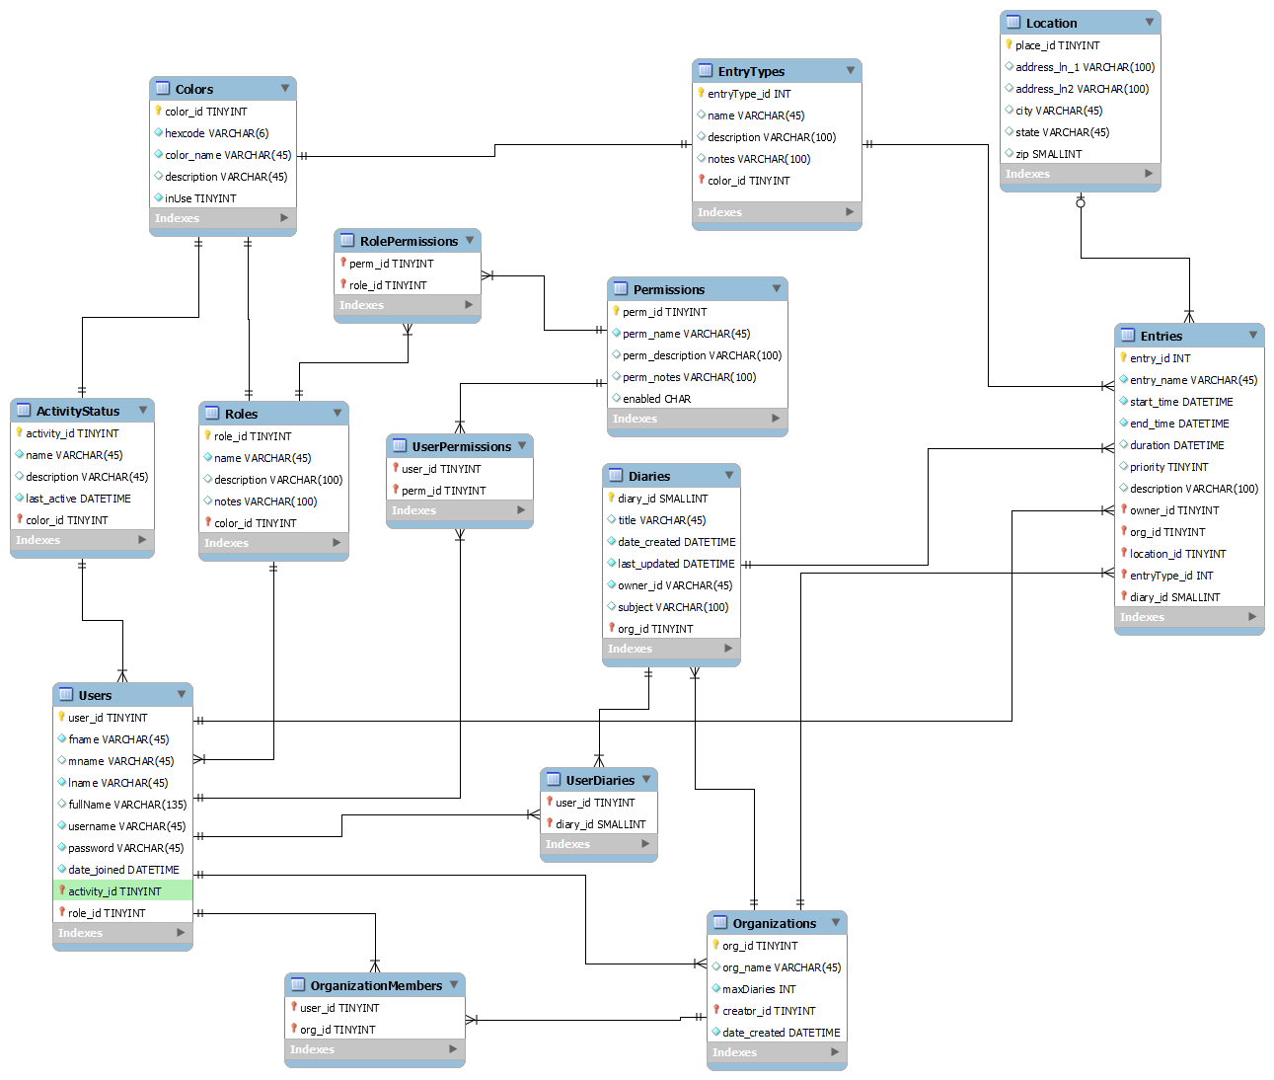
Enhanced Entity Relationship Model (EER)
8
Notes:
Lilli
The Entity Relationship Model is the implementation of the conceptual model in SQL.
Users has a primary key user_id - this is used as a foreign key within Entries (shown as wonder) to establish a one-to-many relationship between Users and Entries, where one user can own many entries
Users also has foreign keys - like from ActivityStatus and Roles - every user has one status and one role. This makes the relationships one to many.
Entries carries a foreign key of users
Some relationships are many-to-many such as users to diaries. One user has access to many diaries, and one diary can be accessed by many users
There is a table that holds only the primary keys of users and diaries and keeps track of every combination.
The relationship between ActivityStatus and Colors is one-to-one; status can only be associated with one color
The relationship between Entries and Location is zero-or-one-to-many. Not every entry needs a location, but location can be attached to multiple entries at a time
The other relationships within the model are all handled in the same ways described above and are as follows:
ActivityStatus to Users: one to many
Roles to Users: one to many
Users to Entries: one to many
Users to Organizations: many to many
Users to Diaries: many to many
Roles to Permissions: many to many
Colors to ActivityStatus: one to one
Colors to Roles: one to one
Colors to EntryTypes: one-to-one
EntryTypes to Entries: one to many
Location to Entries: zero or one to many
Organizations to Entries: one to many
Diaries to Entries: one to many
Organizations to Diaries: one to many

Slide 9
SQL Database Development
SQL Database Development
9

Slide 10
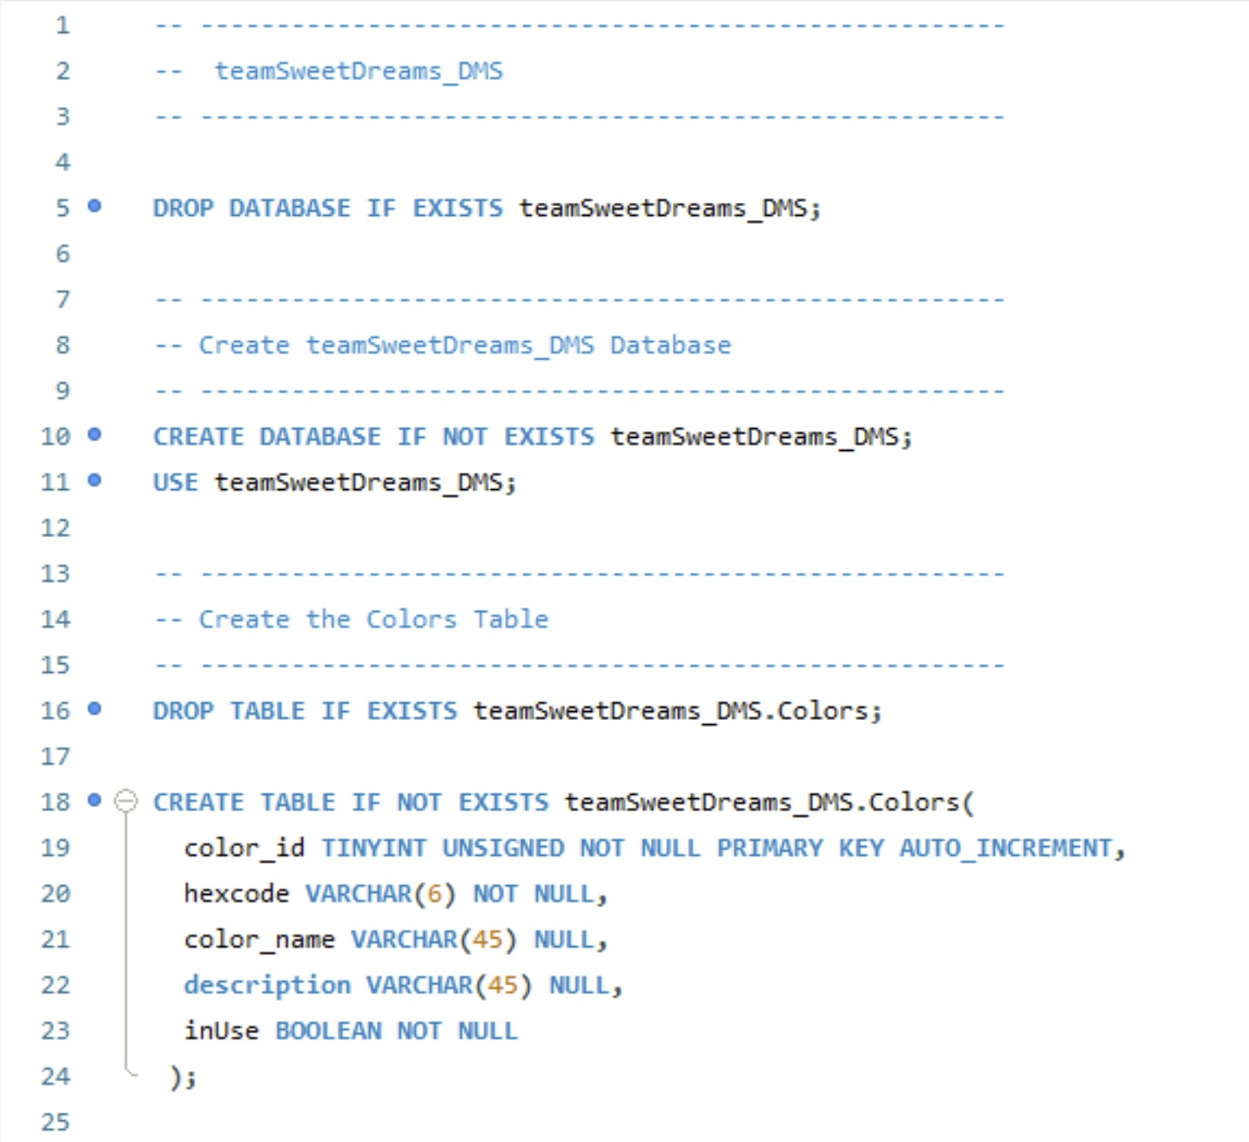
Creating the Database
10
Notes:
Connor

Slide 11
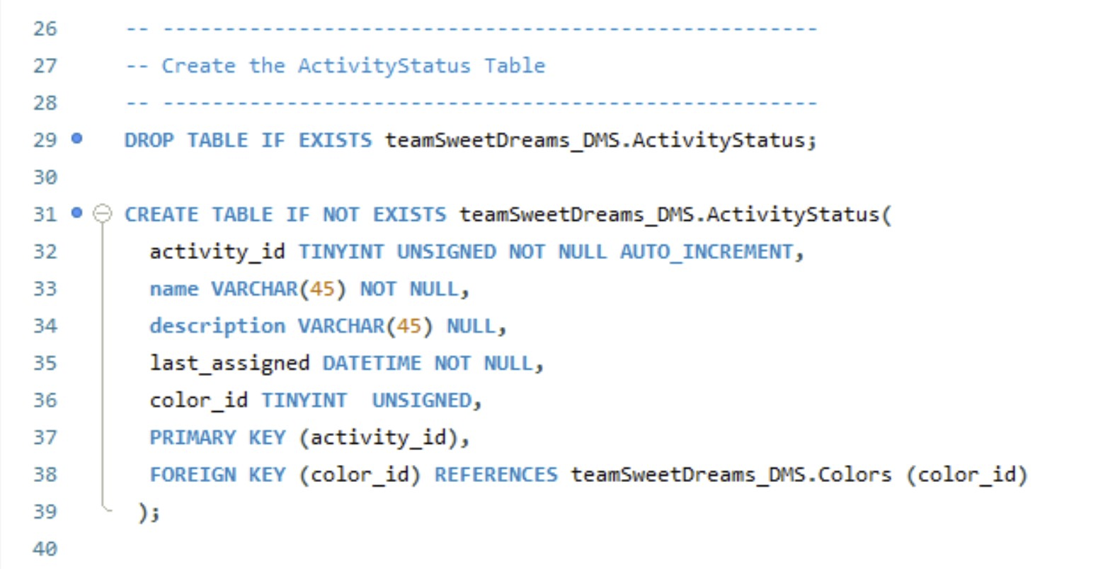
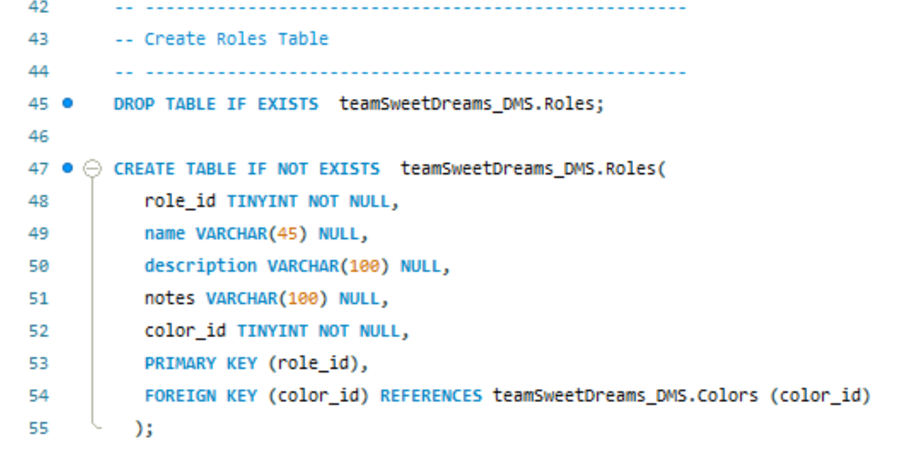
Creating the Database
11
Notes:
Connor

Slide 12
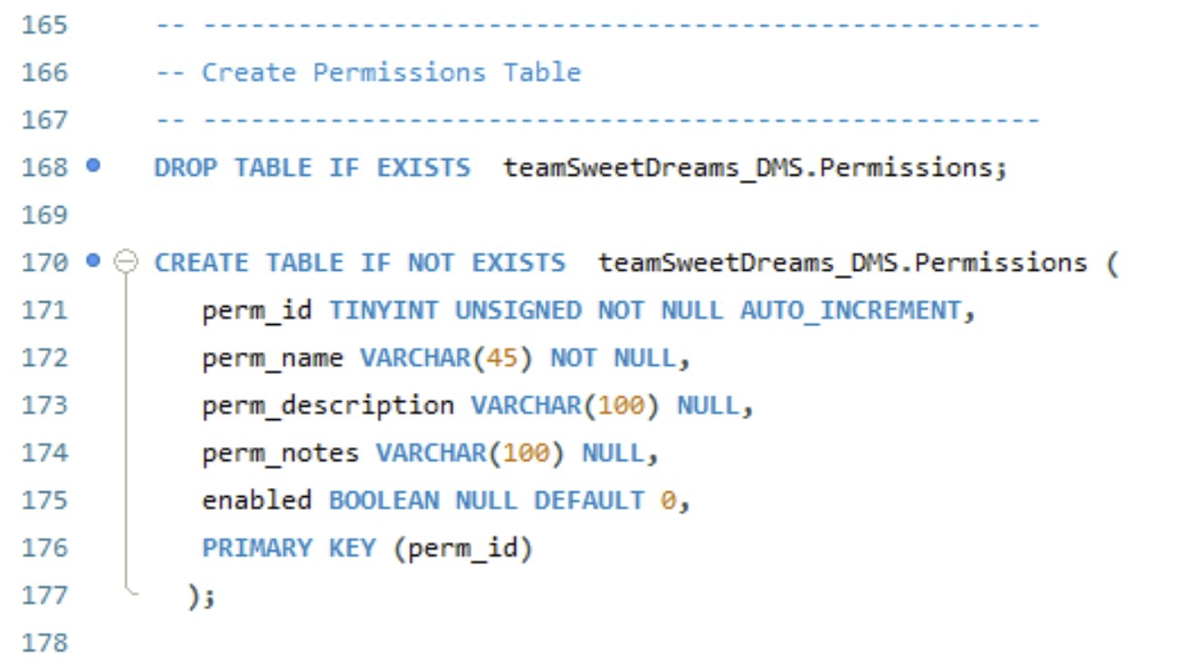
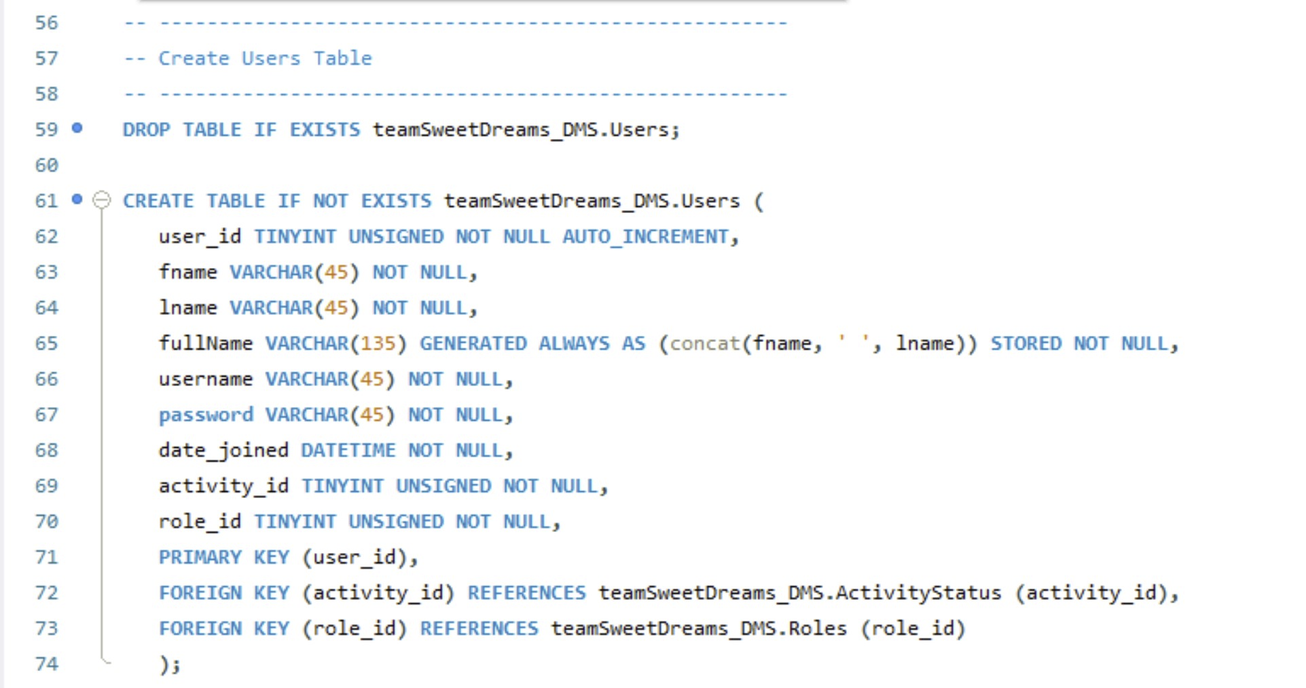
Creating the Database
12
Notes:
Connor

Slide 13
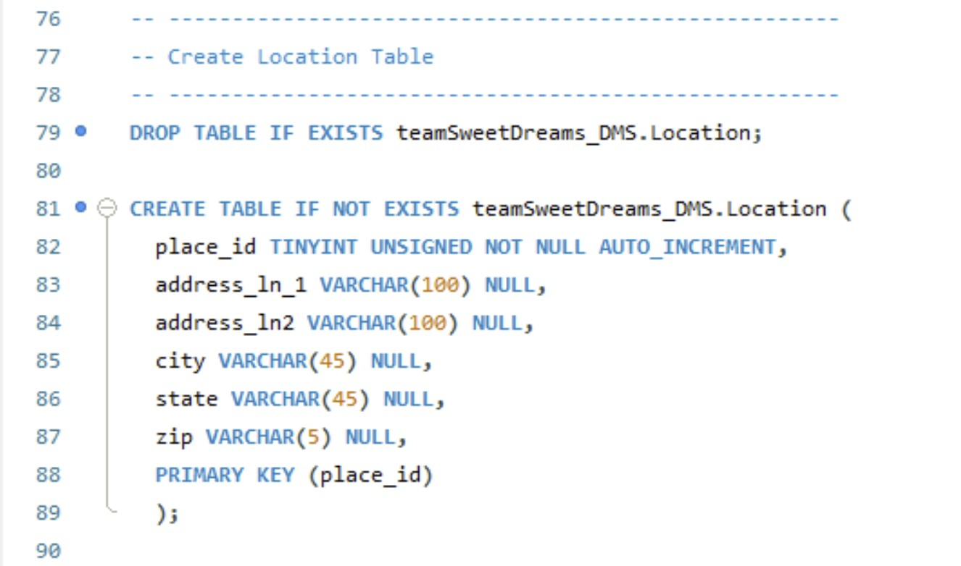
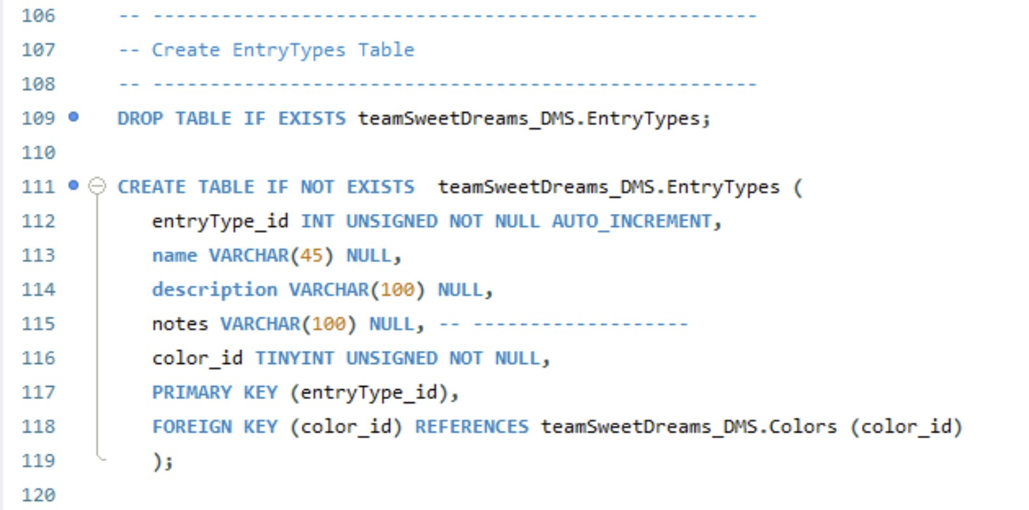
Creating the Database
13

Slide 14
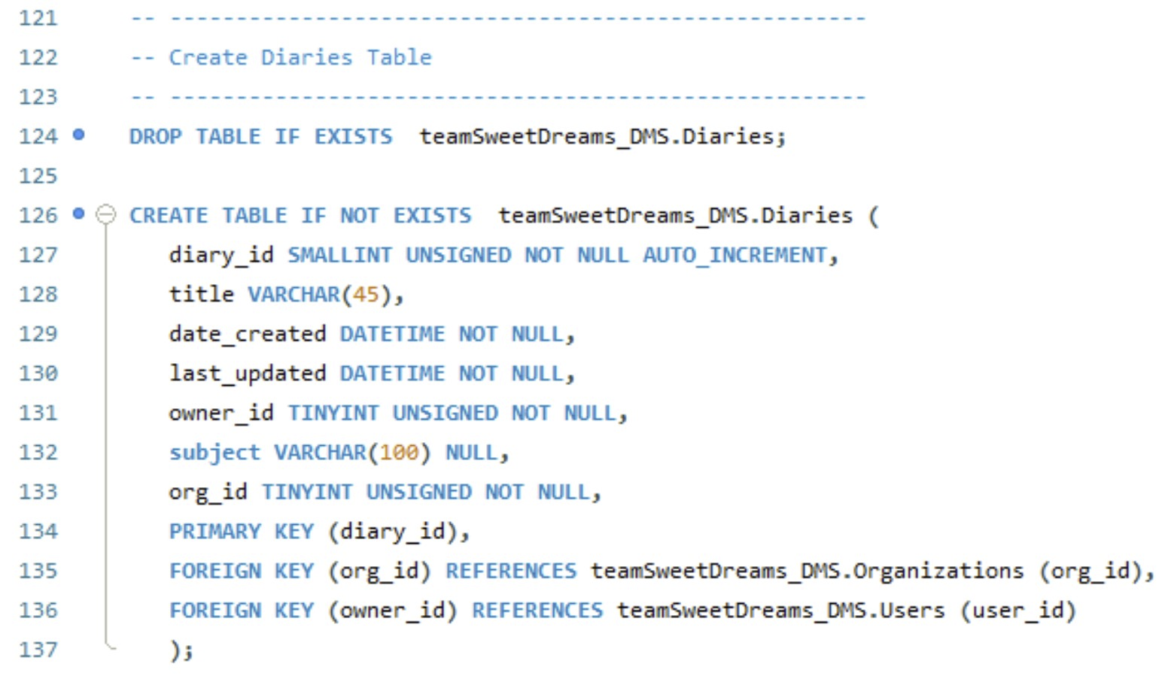
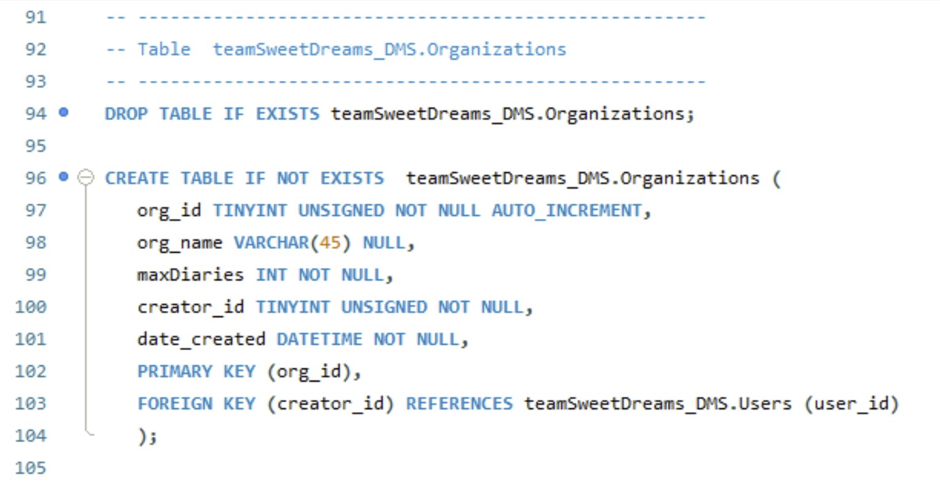
Creating the Database
14

Slide 15
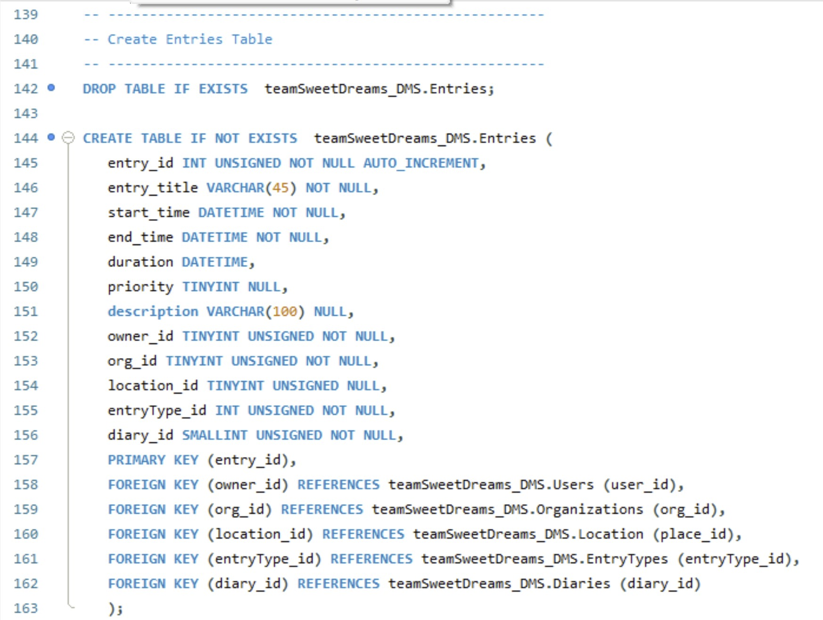
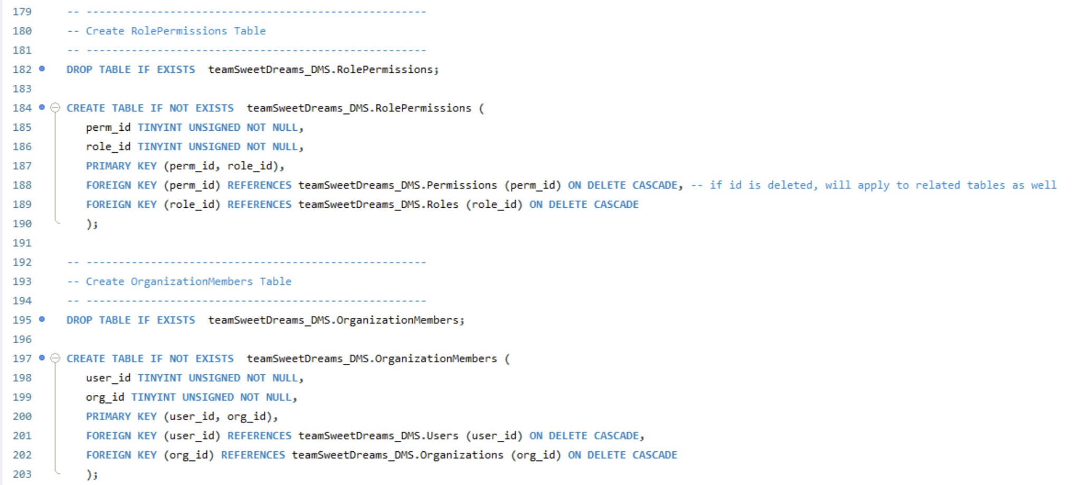
Creating the Database
15

Slide 16
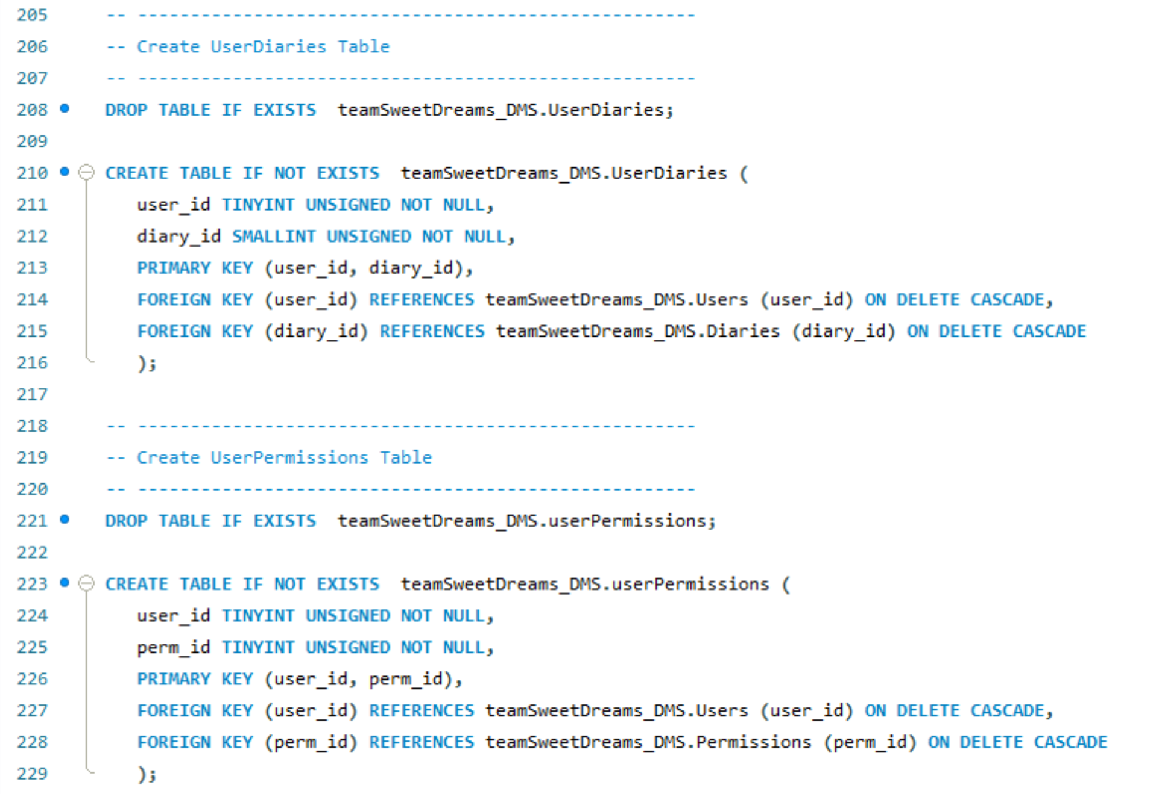
Creating the Database
16

Slide 17
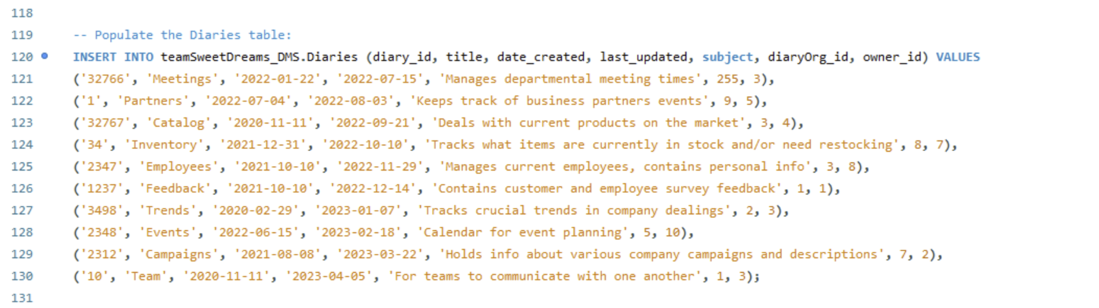
Loading Data
Example of loading data into the Diaries table
17
Notes:
Abel

Slide 18
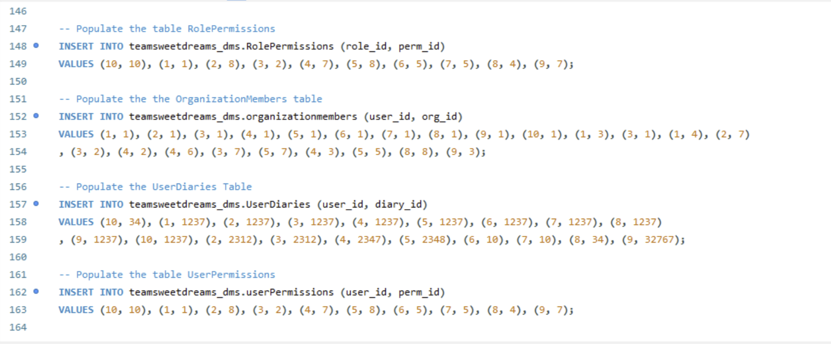
Loading Data
Example of loading the intermediary tables
18
Notes:
Abel

Slide 19
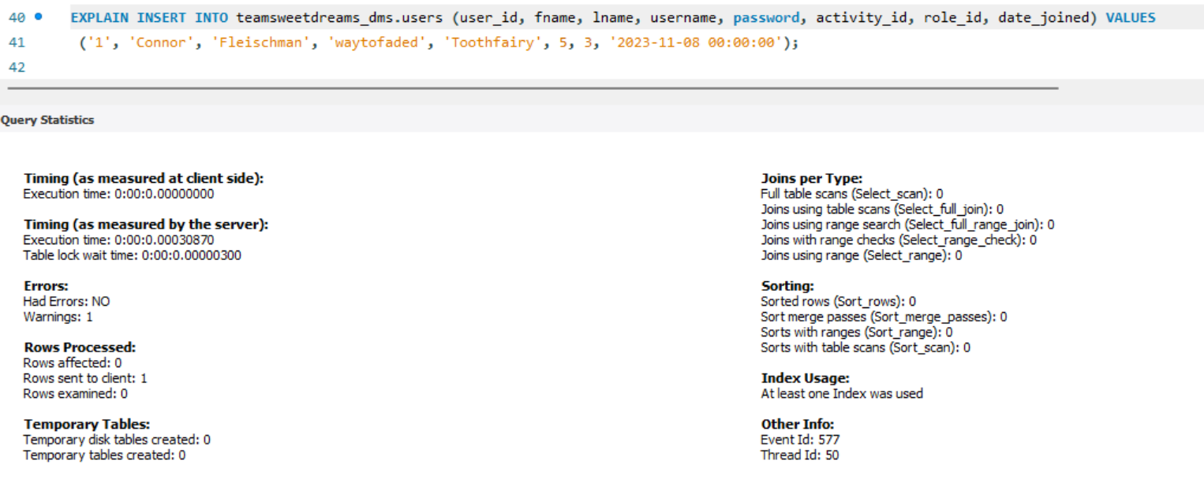
Performance Enhancements
Performance of one INSERT INTO statement with one insert
0.00030870s
19
Notes:
Connor

Slide 20
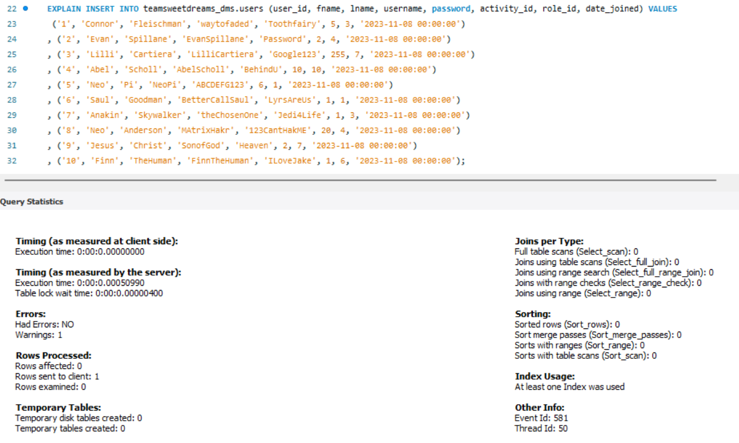
Performance Enhancements
Performance of one INSERT INTO statement with multiple inserts
0.00050990s
20
Notes:
Connor

Slide 21
Graphical User Interface (GUI)
Graphical User Interface (GUI)
21
Notes:
Abel

Slide 22
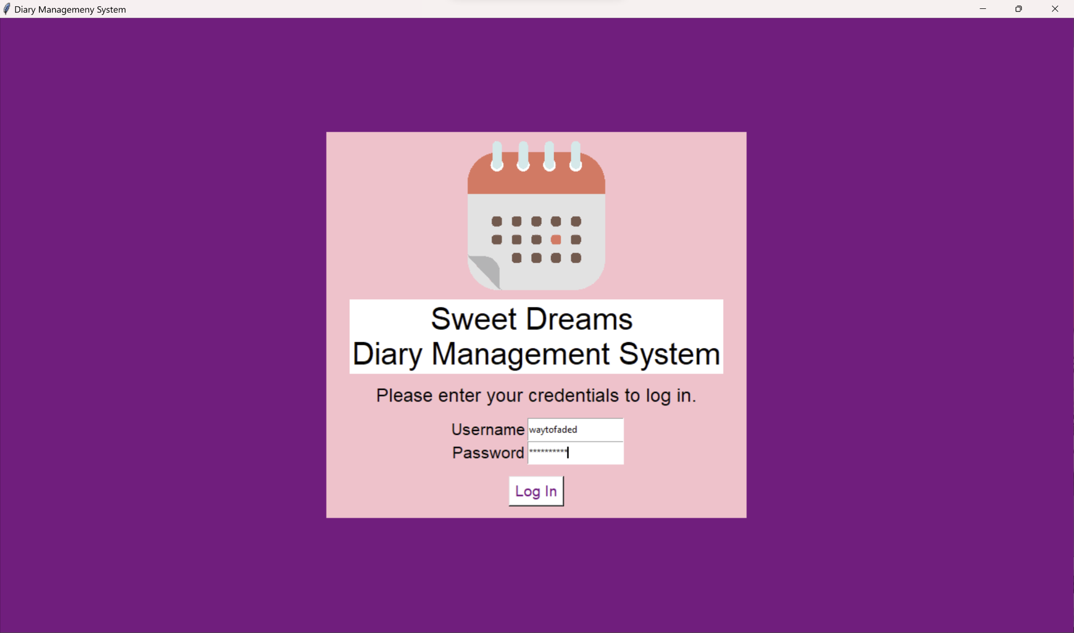
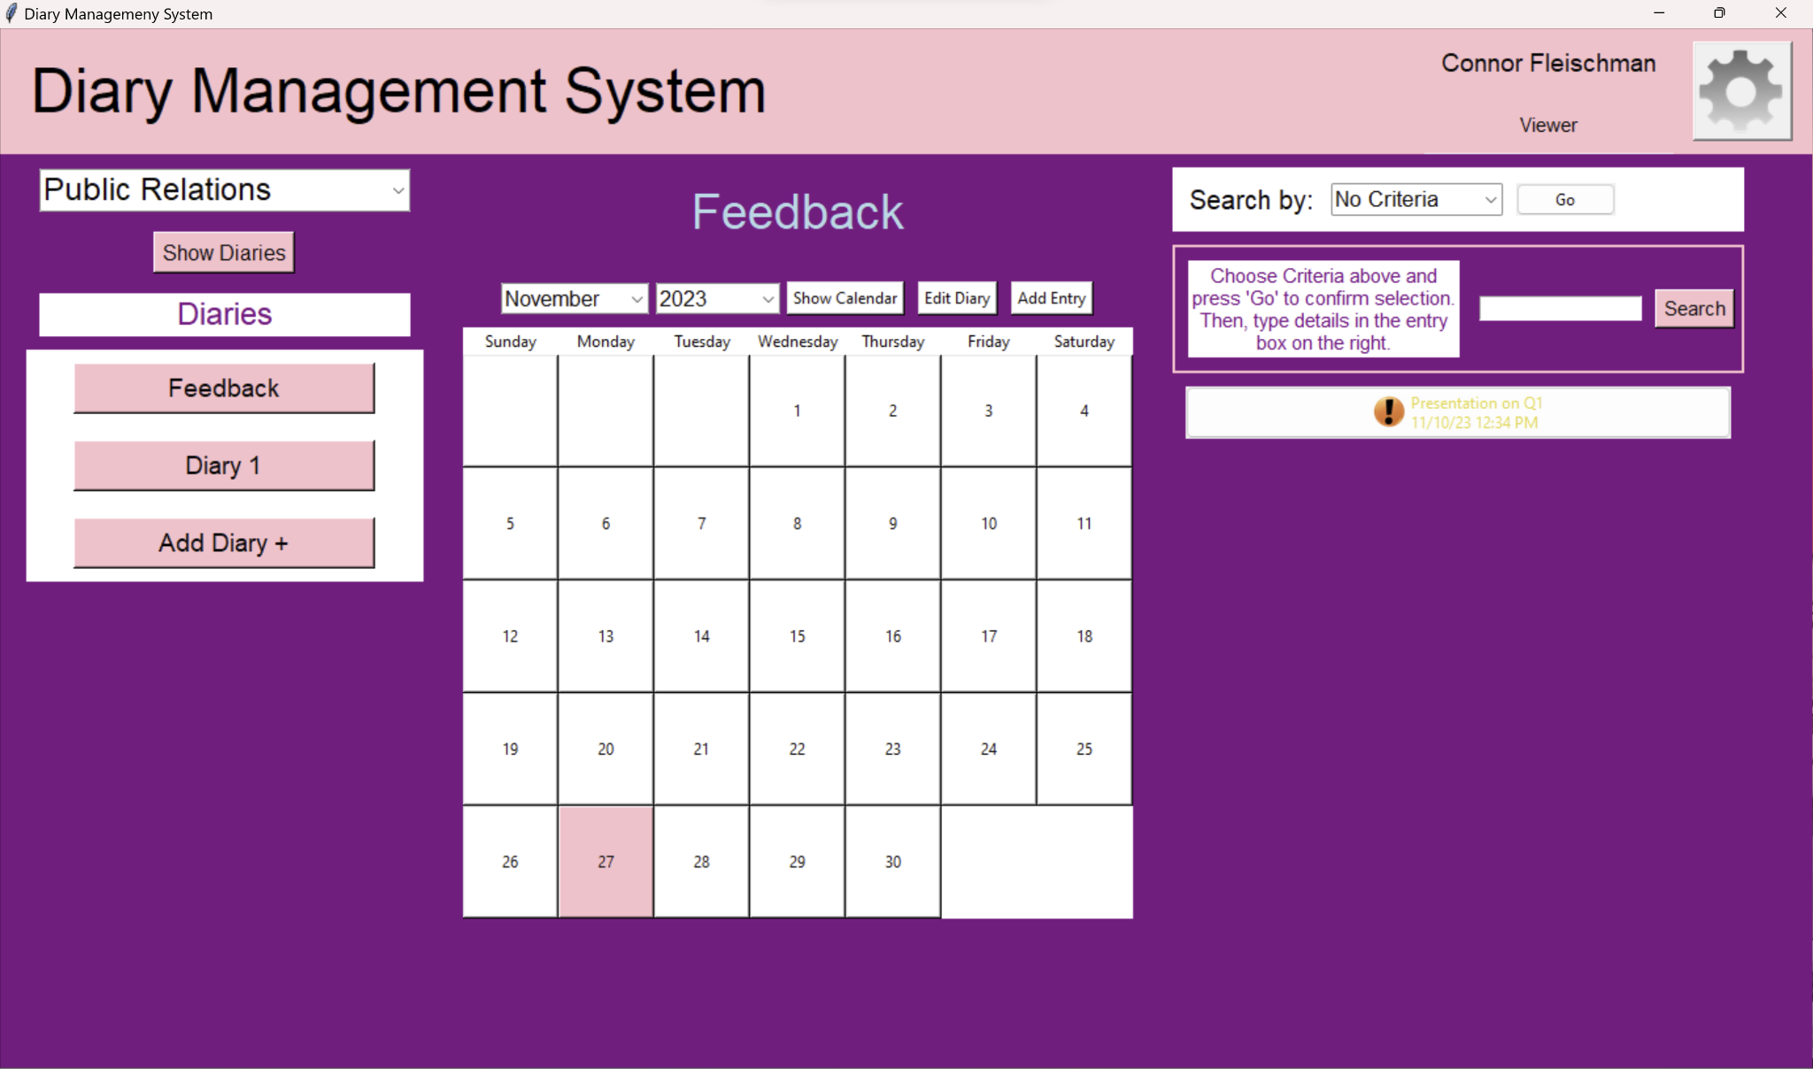
Graphical User Interface (GUI)
Login Page
Main Page
22
Notes:
Abel

Slide 23
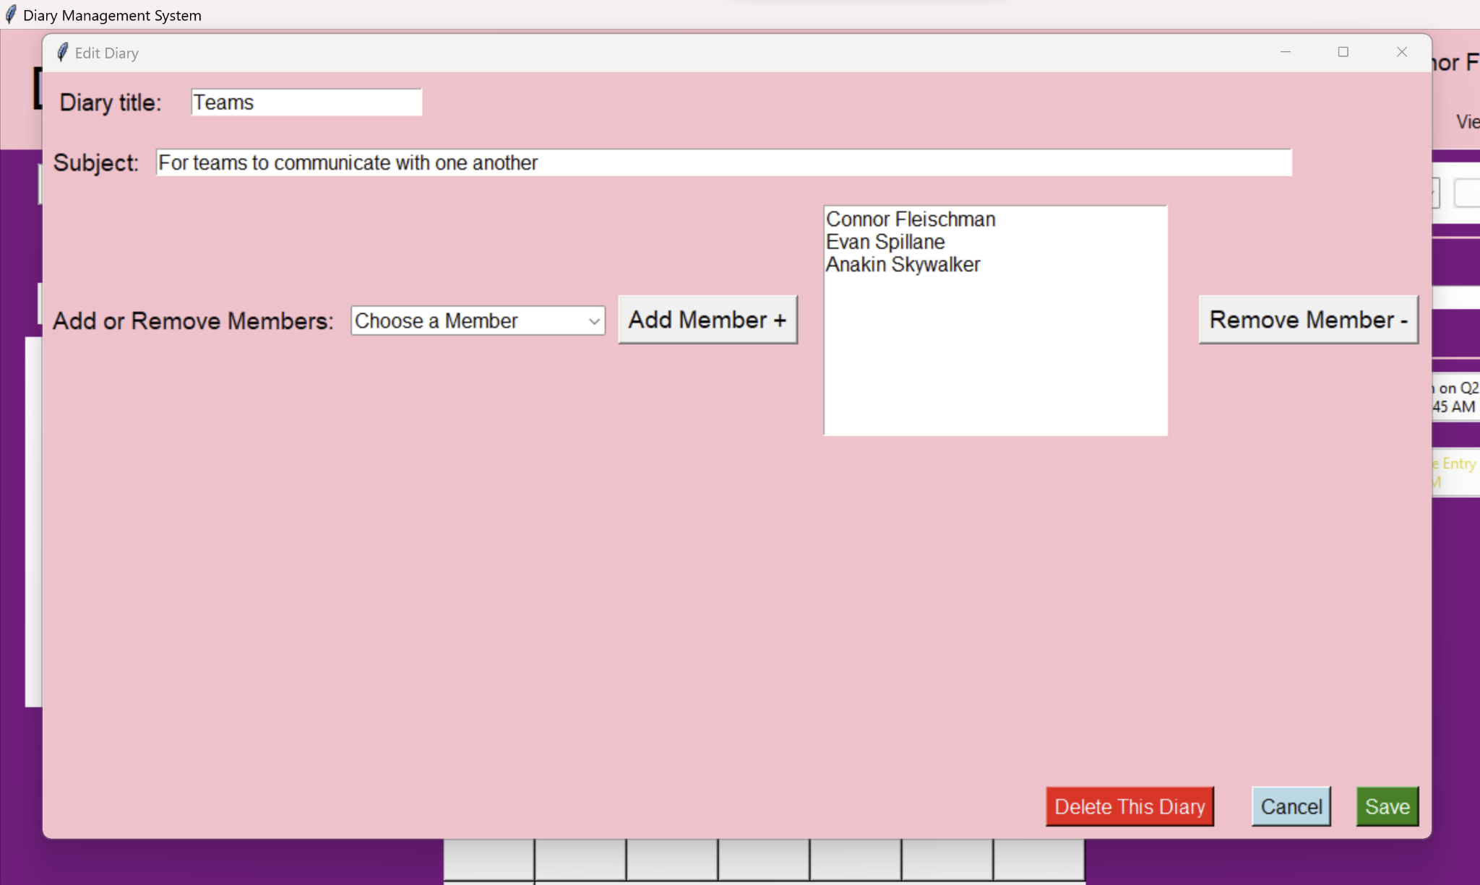
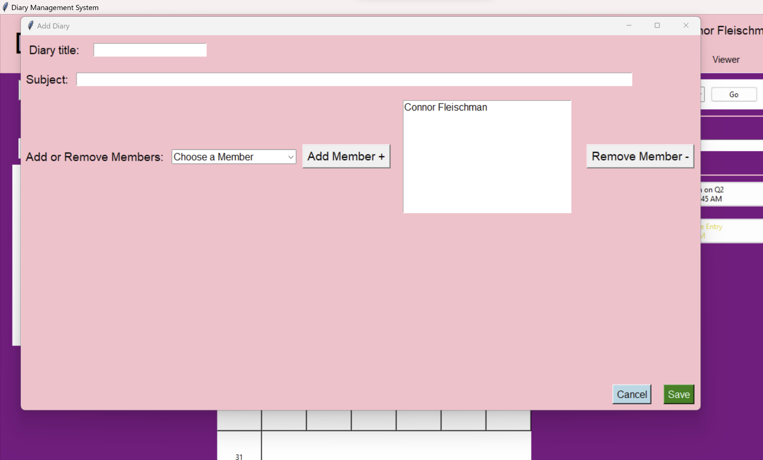
Graphical User Interface (GUI)
Edit Diary Prompt
Add Diary Prompt
23
Notes:
Abel

Slide 24
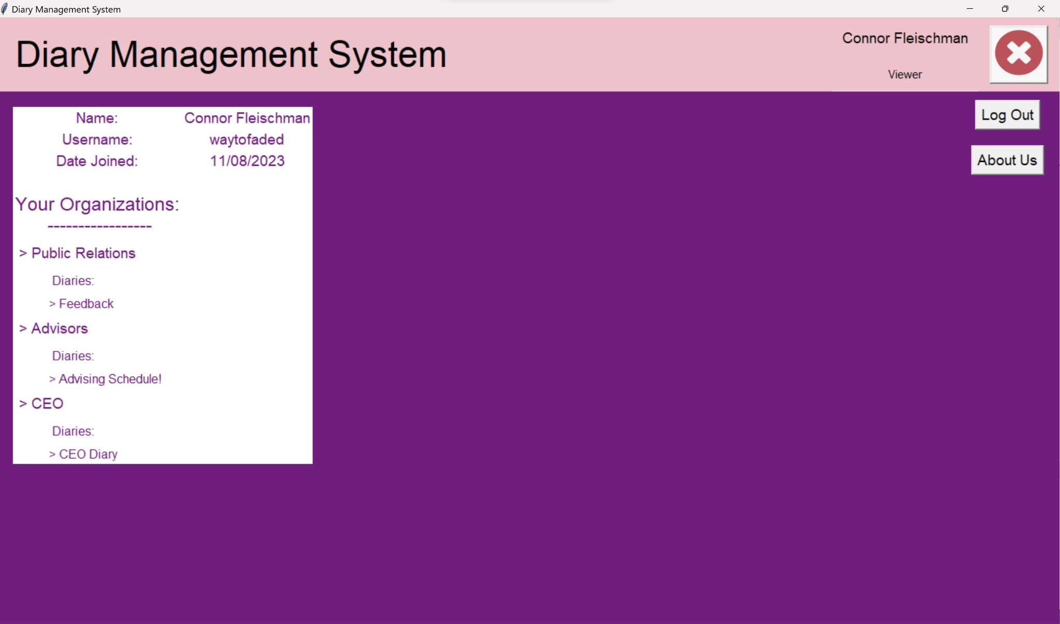
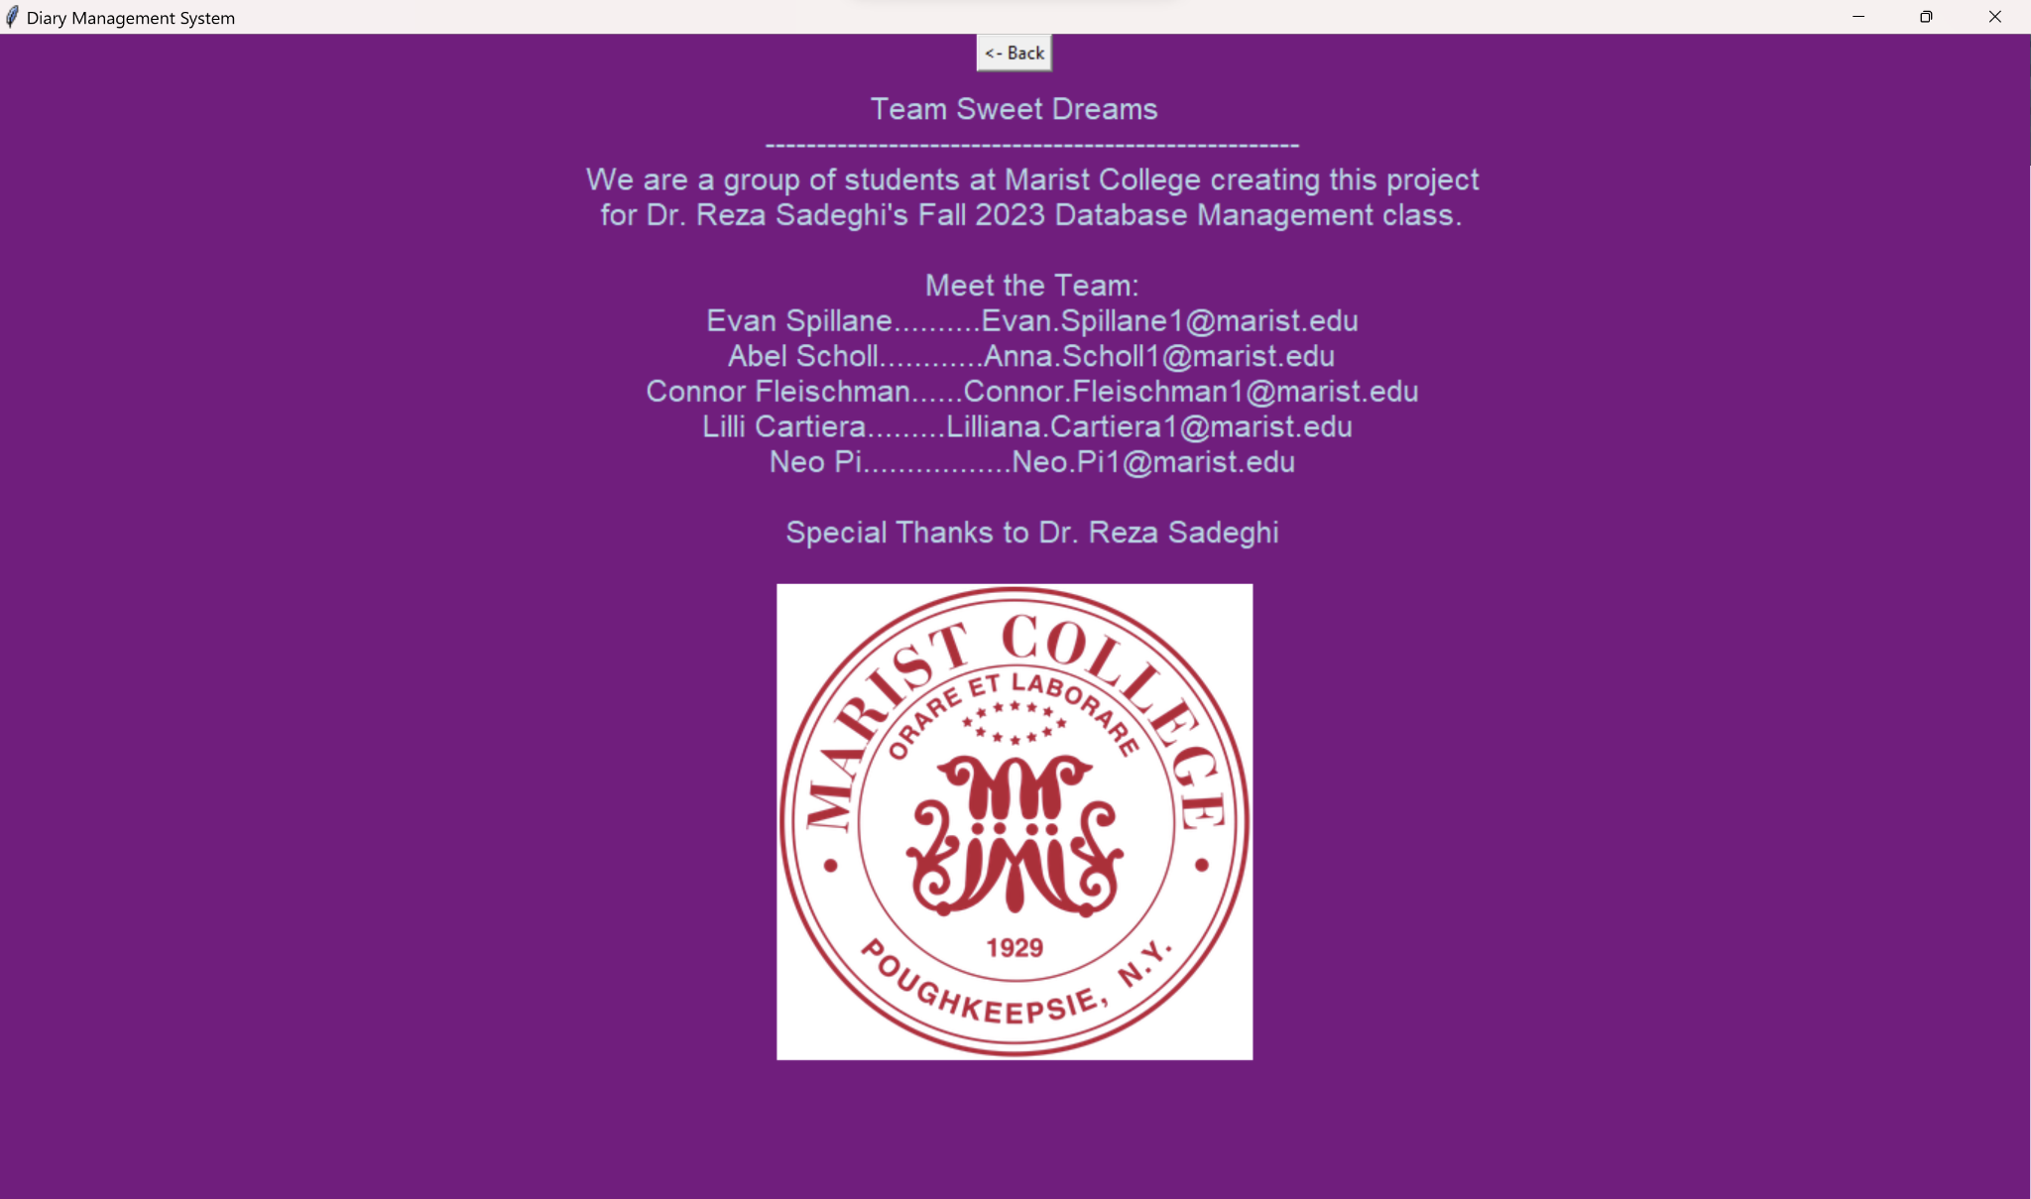
Graphical User Interface (GUI)
User Settings Page
About Us Page
24
Notes:
Abel

Slide 25
References
https://www.eventreference.com/diary-system.php
https://www.setmore.com/diary-management
https://clientdiary.com/
https://www.yworks.com/yed-live/
https://dev.mysql.com/doc/refman/8.0/en/numeric-types.html
https://dev.mysql.com/doc/refman/8.0/en/date-and-time-types.html
https://docs.python.org/3/library/tkinter.html
https://pynative.com/python-mysql-execute-stored-procedure/#h-steps-to-execute-mysql-stored-procedure-in-python
https://www.w3schools.com/sql/sql_case.asp
https://docs.python.org/3/library/datetime.html
https://youtu.be/jGZOKKYUfsU?si=SDRhKlsedWv6JY08
https://dev.to/jakewitcher/using-env-files-for-environment-variables-in-python-applications-55a1
25
Notes:
~~ Audience laughing ~~

Slide 26
Thank You!
Questions?
Notes:
END SLIDE, DO NOT DELETE

